Slide 1
Data Structures

Slide 2
Agenda
Print all Nodes at a distance k from a given node
Sets
Maps
HashSet and HashMap Class
Count distinct elements in every window

Slide 3
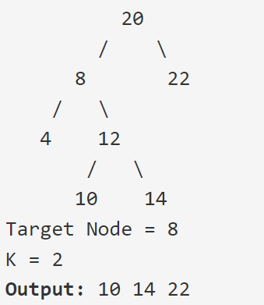
Print all Nodes at a distance k from a given node
Link: https://practice.geeksforgeeks.org/problems/nodes-at-given-distance-in-binary-tree/1#

Slide 4
Print all Nodes at a distance k from a given node
Link: https://practice.geeksforgeeks.org/problems/nodes-at-given-distance-in-binary-tree/1#

Slide 5
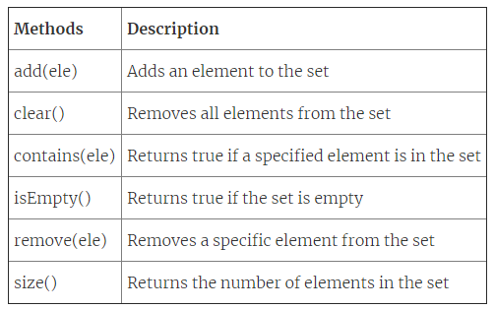
Sets
A set is a collection of unordered elements without any duplicates.
Properties:
Unlike lists and stacks, the elements present in a set do not follow any particular order. They are randomly present in the set.
The elements are not repeated in a given set.
Usage: A set can be used to determine if a node is a neighbor of another node i.e. if you store all of node A’s neighbours as a set, you can use the contains() method to quickly find out if a node named X is a neighbor of node A.

Slide 6
Maps
Maps represent a collection type that provides connection or mapping between the elements of a source set (domain) and a target set (range).
A Map cannot contain duplicate keys and each key can map to at most one value.(Keys are unique but values can be repeated)
Methods in Map Interface:
public Object put(Object key, Object value): This method is used to insert an entry in this map.
public void putAll(Map map): This method is used to insert the specified map in this map.
public Object remove(Object key): This method is used to delete an entry for the specified key.
public Object get(Object key):This method is used to return the value for the specified key.
public boolean containsKey(Object key): This method is used to search the specified key from this map.
public Set keySet(): This method is used to return the Set view containing all the keys.
public Set entrySet(): This method is used to return the Set view containing all the keys and values.

Slide 7
HashSet and HashMap Class

Slide 8
Count distinct elements in every window
Link: https://practice.geeksforgeeks.org/problems/count-distinct-elements-in-every-window/1/

Slide 9
Count distinct elements in every window
Link: https://practice.geeksforgeeks.org/problems/count-distinct-elements-in-every-window/1/

Slide 10
Count distinct elements in every window
Link: https://practice.geeksforgeeks.org/problems/count-distinct-elements-in-every-window/1/

Slide 11
THANK YOU

